Slide 1
TECHTRONIX INNOVATIONS

Slide 2
Business Overview
Forefront player in the microchip and robotics industry
Has an extensive portfolio that caters to automotive, consumer electronics and industrial sectors

Slide 3
Problem Statement
Encountering challenges in:
Streamlining its sales strategies
Optimizing production planning
Pursuing market expansion
Grapples with demand unpredictability
Inventory management inefficiencies
Identification of profitable market opportunities

Slide 4
Aim of Project
To provide insights into Techtronix:
Sales Performance
Customer Patterns
Inventory Optimization
Profitability
Market Expansion Opportunities

Slide 5
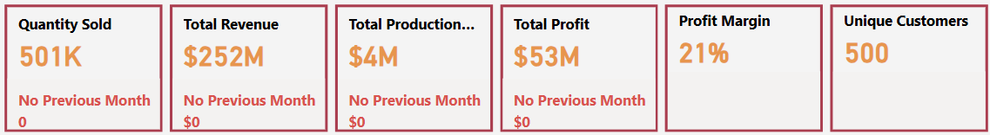
Key Insights
Key Performance Indicators
Current sales figures compared to previous month, highlighting significant changes
A quick view of overall customer engagement and profitability
Signals current efficiency in inventory management

Slide 6
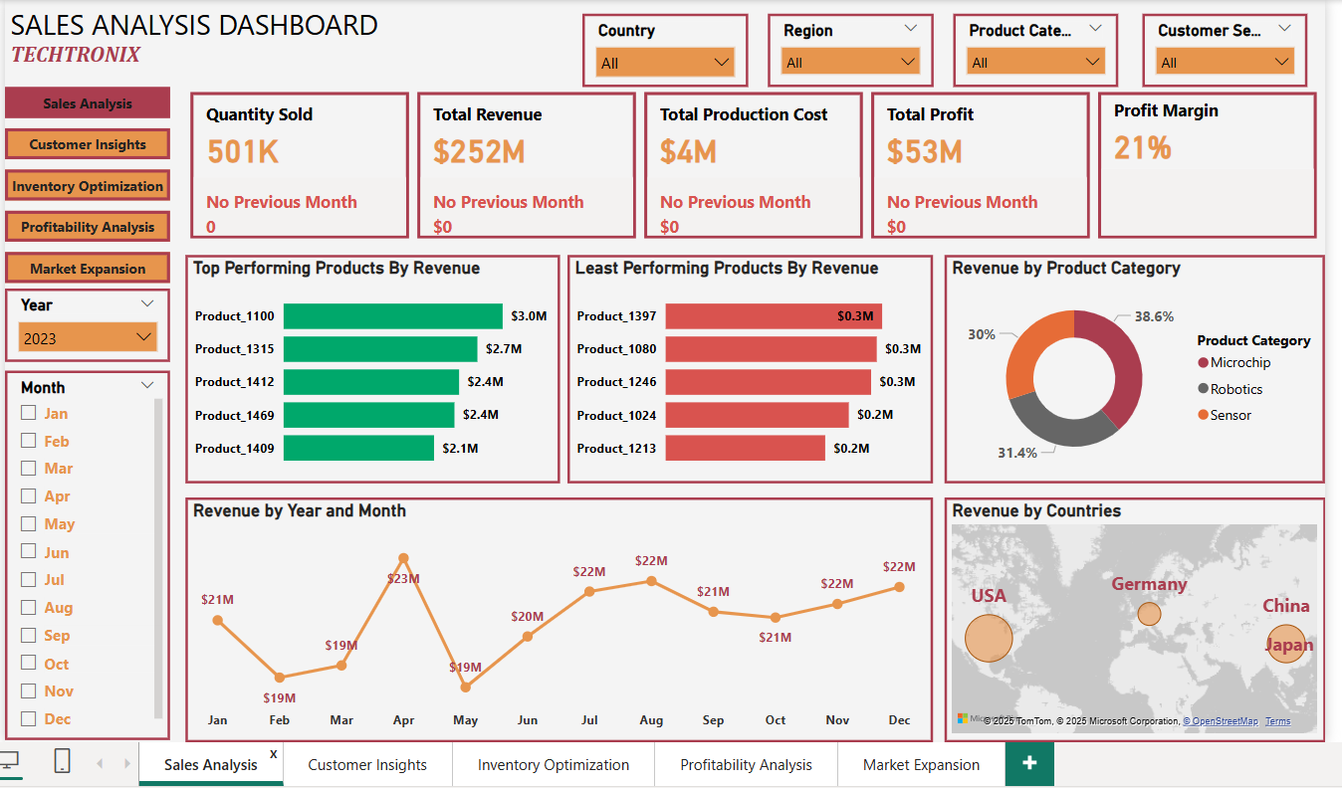
Sales Performance Dashboard

Slide 7
Sales Performance Analysis – Key Issues & Action Points
Goal: To guide strategic decisions as to increase overall revenue and improve profit margins
Top & Bottom Performers
Key Issue: Significant disparity between high and low performing product indicates a need for product rationalization or targeted marketing to boost underperforming products.
Monthly Sales Trends
Peak in March: $23M
Dip in May: $19M, followed by gradual recovery toward end of year
Key Issue: Fluctuations suggest seasonality or uneven demand. Could require refined production planning and sales strategies (e.g., promotional campaigns in lower-demand months).
Product Category Breakdown
Key Issue: Balancing Research and Demand and marketing efforts across categories to capitalize on growth areas.
Geographical Insights
Key Issue: Potential to expand in regions showing strong demand (e.g., Asia) and re-evaluate strategy in underperforming regions.
Action Points
Optimize Low-Performing Products: Investigate causes (pricing, quality, competition) and consider discontinuation or revamp.
Address Seasonal Trends: Align production and promotional activities with high-demand months to avoid over/under-stocking.
Focus on High-Potential Markets & Categories: Scale marketing in regions/categories with proven growth and high margins.

Slide 8
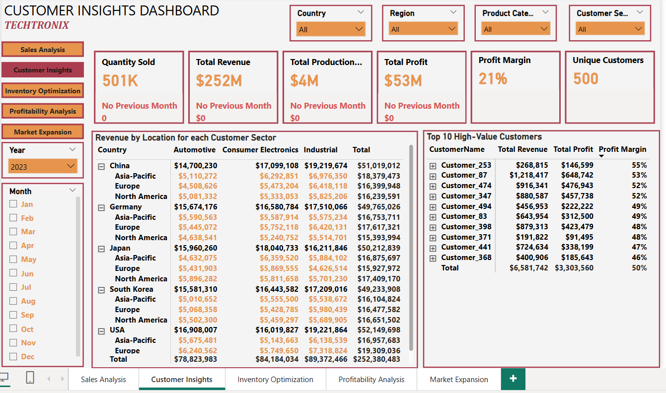
Customer Insights Dashboard

Slide 9
Customer Insights Analysis – Key Insights & Action Points
Goal: To prioritize product development, marketing investments and customer relationship strategies for maximum impact
Revenue by Location & Customer Sector
Top Countries: USA ($52.1M), China ($51.0M), Japan ($50.2M), Germany ($49.7M), South Korea ($49.2M)
Leading Customer Sectors: Industrial ($89.4M), Consumer Electronics ($84.1M), Automotive ($78.8M)
Key Insight: Industrial is the highest-revenue sector across multiple regions, indicating strong Business-to-Business demand.
Top 10 High-Value Customers
Collectively generate $6.58M in revenue and $3.30M profit (~50% margin).
Highest Earner: Customer_87 ($1.22M revenue, $648K profit, 53% margin).
Key Insight: These customers have above-average margins, suggesting a profitable segment to nurture.
Geographic & Customer Sector Insights
USA leads overall revenue, but China and Japan closely follow, signaling significant market potential in Asia.
Automotive is strong in traditional hubs (e.g., Germany, Japan), while Consumer Electronics and Industrial have broad global appeal.
Action Points
High-Margin Segments: Focus on retaining and upselling high-value customers who drive profitability.
Growth Opportunities: Expand Industrial and Consumer Electronics offerings, especially in Asia-Pacific where demand is high.
Diversification Strategy: Leverage strong performance in multiple sectors/countries to reduce risk and capture emerging market share.

Slide 10
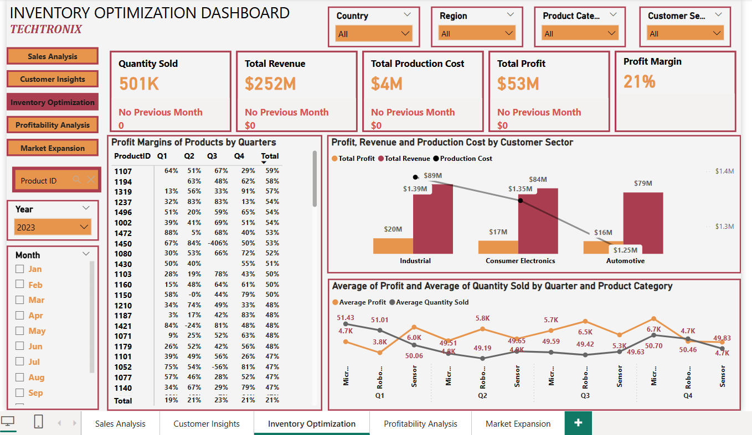
Inventory Optimization Dashboard

Slide 11
Inventory Optimization Analysis – Key Insights & Action Points
Goal: To refine production planning by ultimately, reducing excess inventory, cutting costs and maximizing profits
Quarterly Product Profit Margins
The Matrix reveals varying profit margins by quarter (e.g., Product 1107 at 64% in Q1 but 29% in Q4).
Key Issue: Some products show sharp drops or even negative margins in later quarters (e.g., Product 1450 with -406% in Q4), indicating mismatched production levels or rising costs.
Customer Sector Profit, Revenue & Production Cost
Industrial leads with $89M revenue, while Automotive hits $79M and Consumer Electronics follows at $84M.
Production costs remain relatively low across sectors (hovering around $1.25M–$1.39M), suggesting potential for higher profitability if demand is matched accurately.
Average Profit & Quantity Sold (By Quarter & Product Category)
Microchips see higher average profit, but moderate quantity sold; Sensors exhibit peaks in quantity sold (e.g., 5.8K in Q2) but slightly lower average profit.
Key Issue: Demand shifts each quarter, implying the need for dynamic production planning and flexible inventory strategies.
Action Points
Forecasting & Analytics: Implement more accurate demand forecasting models (seasonality, market trends) to avoid over/underproduction.
Adaptive Production Schedules: Adjust manufacturing output based on real-time sales data to maintain optimal stock levels.
Cost Management: Investigate high production cost spikes and negative margin products to optimize resource allocation or renegotiate supplier contracts.
Cross-Functional Collaboration: Ensure Sales, Marketing, and Operations teams share insights to fine-tune inventory decisions and promotional timing.

Slide 12
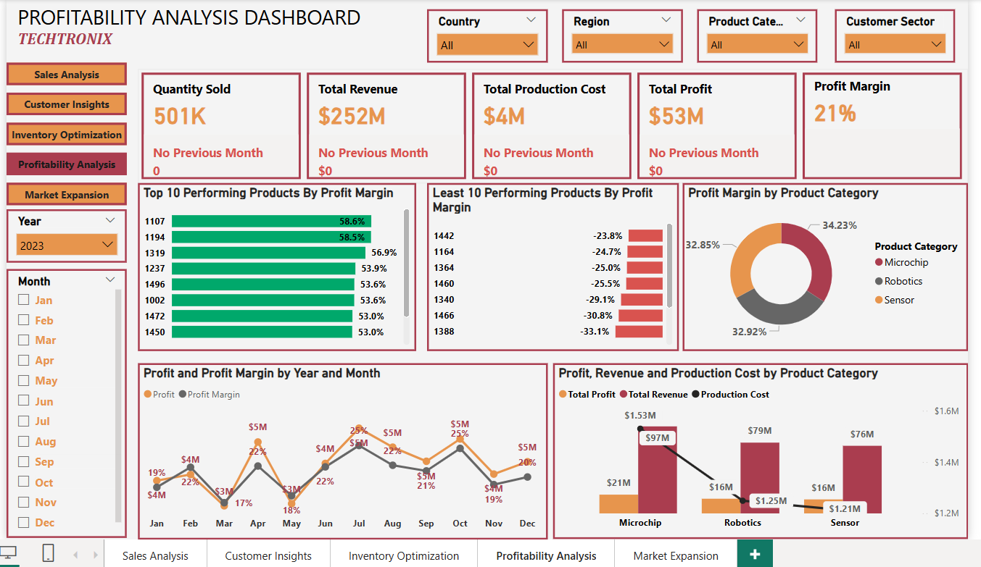
Profitability Analysis Dashboard

Slide 13
Profitability Analysis – Key Insights & Action Points
Goal: To boost overall profit, reduce unnecessary costs and strengthen market position across all product categories
Top vs. Bottom Performing Products
Top 10 Products by Profit Margin demonstrate strong pricing or cost efficiency.
Least 10 Products by Profit Margin show negative margins, indicating potential cost overruns or mispricing.
Profit & Profit Margin Trends by Month
Monthly profit fluctuates between $4M–$5M, while profit margin varies from 19% to 25%.
Key Issue: Certain months see sharp margin dips, suggesting seasonal costs or demand shifts that require better cost controls or promotional strategies.
Product Category Analysis
In the bar chart, Microchip shows $97M revenue with $21M profit, whereas Robotics and Sensor hover around $79M and $76M respectively.
Key Issue: Microchip offers the highest margin and revenue potential, making it a prime candidate for further investment.
Action Points
Streamline Production Costs for underperforming products (e.g., renegotiate supplier contracts, optimize manufacturing processes).
Adjust Pricing or Discontinue consistently negative-margin products to prevent dragging overall profitability.
Focus on High-Margin Segments (Microchip) for additional Research & Development and marketing to scale profitable product lines.
Monthly Monitoring & Forecasting: Leverage sales forecasts to align production and minimize waste or overstock.

Slide 14
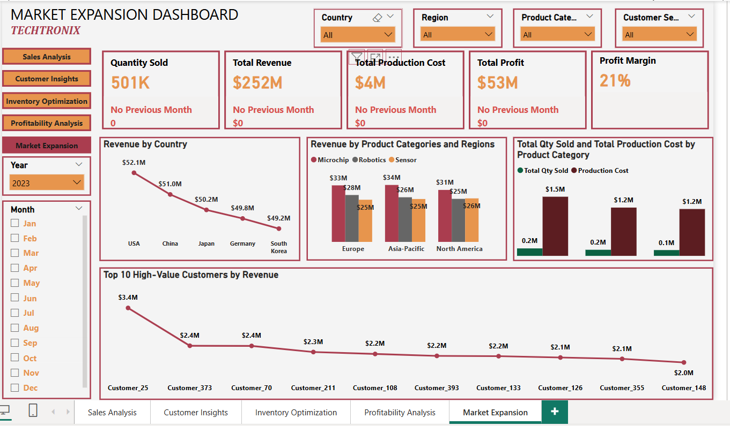
Market Expansion Dashboard

Slide 15
Market Expansion Analysis – Key Insights & Action Points
Goal: To unlock new revenue streams and solidify its global market position
Regional & Product Category Breakdown
Microchip consistently leads revenue across Europe ($33M), Asia-Pacific ($34M), and North America ($31M).
Robotics and Sensor also show strong performance, especially in Asia-Pacific and North America.
Key Issue: Leverage Microchip’s strong demand in all regions, while boosting Robotics/Sensor in Asia-Pacific (rapid tech adoption) and North America (high purchasing power).
Production Cost vs. Quantity Sold
Microchip has the highest quantity sold (1.5M) but moderate production cost ($0.2M), suggesting economies of scale.
Sensor also shows a favorable cost-to-quantity ratio, indicating potential for high-margin expansion if marketed effectively.
High-Value Customers
Customer_25 tops the list at $3.4M, with subsequent customers in the $2.0–$2.4M range.
Key Issue: Expand into similar customer profiles or related industries to replicate these high-value relationships in new markets.
Action Points
Focus on High-Demand Regions: Increase market presence in Asia-Pacific and North America, capitalizing on existing Microchip and Sensor demand.
Scale Robotics Offerings: Robotics demand is growing, especially in tech-driven regions; consider targeted Research & Development and marketing.
Leverage Economies of Scale: With Microchip production already efficient, further scale operations or introduce new variants to capture more market share.
Customer Acquisition Strategy: Identify and pursue customers with profiles similar to top earners, ensuring quick (Return of Investment) ROI in newly targeted markets.

Slide 16
Overall Performance & Key Takeaways
Steady Sales & Profit: With 501K units sold, $252M in revenue, and $53M profit, Techtronix maintains a 21% margin—indicative of solid financial health.
Strong Product Portfolio: Microchip, Robotics, and Sensor dominate sales, with Microchip showing both high revenue and favorable production costs.
Geographic Distribution: The USA, China, Japan, Germany, and South Korea drive most revenue, suggesting multiple viable regions for deeper market penetration.
High-Value Customers: A subset of top customers generates disproportionately large revenue and profit, highlighting the importance of targeted retention and cross-selling strategies.

Slide 17
Challenges & Observations
Underperforming Products: Some items exhibit negative margins, indicating mispricing, inefficient production, or low demand.
2. Inventory Mismatches: Fluctuating inventory vs. sales suggests a need for more accurate forecasting and flexible production scheduling.
3. Profitability Variations: Profit margins dip in certain months or sectors, pointing to seasonal effects or cost overruns that warrant investigation.
4. Untapped Market Opportunities: High-potential regions (e.g., Asia-Pacific, North America) and product lines (e.g., Robotics, Sensors) could yield higher returns with strategic focus.

Slide 18
Recommendations
Optimize Product Mix
Discontinue or Revamp consistently negative-margin products.
Double Down on high-margin categories (e.g., Microchip) and invest in R&D to maintain a competitive edge.
Enhance Demand Forecasting & Inventory Management
Implement advanced analytics (predictive modeling) to align production with real-time sales trends.
Reduce Overstocks & Stockouts by closely monitoring lead times and sales cycles.
Focus on High-Value Customers
Develop loyalty programs or bundled offerings for top earners to increase share-of-wallet.
Expand customer acquisition efforts targeting profiles similar to existing high-value clients.
Leverage Growth Markets
Increase marketing and distribution in regions with strong or growing demand (e.g., Asia-Pacific, North America).
Adapt product features to local needs and regulations to capture emerging opportunities.
Monitor Costs & Margins Continuously
Renegotiate supplier contracts where costs are high.
Track monthly/quarterly margin fluctuations to address inefficiencies quickly.
Conclusion
By strengthening product strategies, optimizing inventory, and capitalizing on high-potential markets, Techtronix Innovations can sustain profitability, improve cost efficiency, and unlock new growth avenues in the global marketplace.

